Slide 1
Parking Guidance System Solution

Slide 2
About Us
Mr.Nguyễn Đức Lợi
Supervisor
Trần Nguyễn Minh Trung
Firmware: System architecture & interface protocol
Software: Android Application
Bùi Phú Hiệp
Nguyễn Đỗ Phương Huy
Hardware: Design & Implement
Software: Web Server
Hardware: Implement
Testing: Design and Execute

Slide 3
Outline
Problem
Solution
How the System Works
Web Service
Hardware
Firmware & Software Implement
Advantages & Disadvantages
Future Plan
Demo

Slide 4
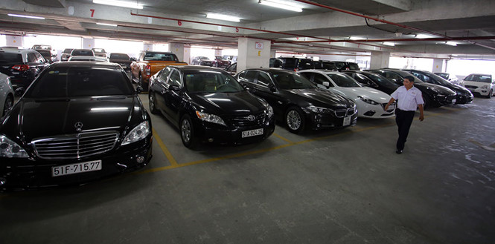

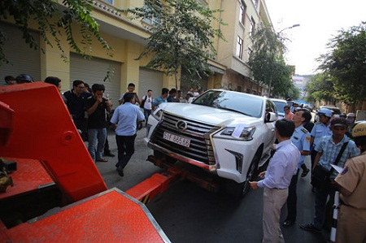
Problem

Slide 5
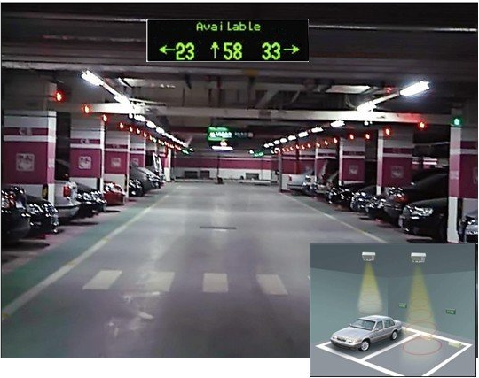
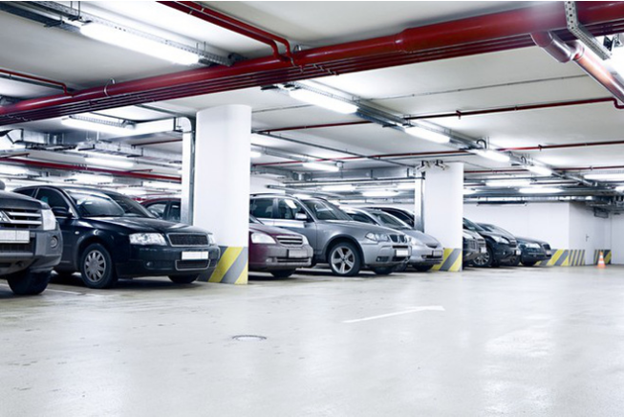
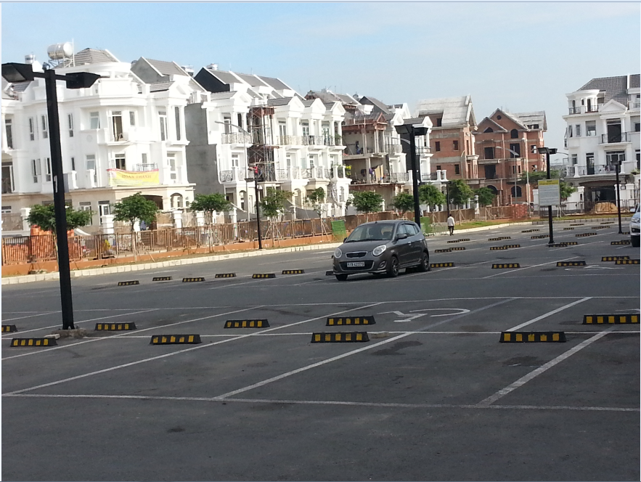
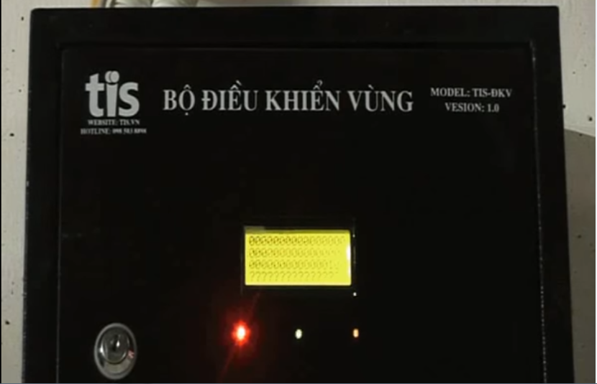
Problem
Notes:
6 bãi xe, dự kiến 3000 chỗ mỗi bãi

Slide 6
Problem
Complicated planning of wired system
Incompatible with outdoor system
Limited information provided to drivers

Slide 7
Solution

Slide 8

How the system works

Slide 9

How the system works

Slide 10

How the system works

Slide 11

How the system works

Slide 12
How the system works
Collect Data

Slide 13
How the system works
Update Information

Slide 14

How the system works
Send data

Slide 15
How the system works
Receive command

Slide 16
How the system works
Update Status

Slide 17
How the system works

Slide 18
How the system works
Collect Data

Slide 19

How the system works
Get Information

Slide 20
How the system works
Issue a command

Slide 21
How the system works
Send Command

Slide 22
How the system works

Slide 23
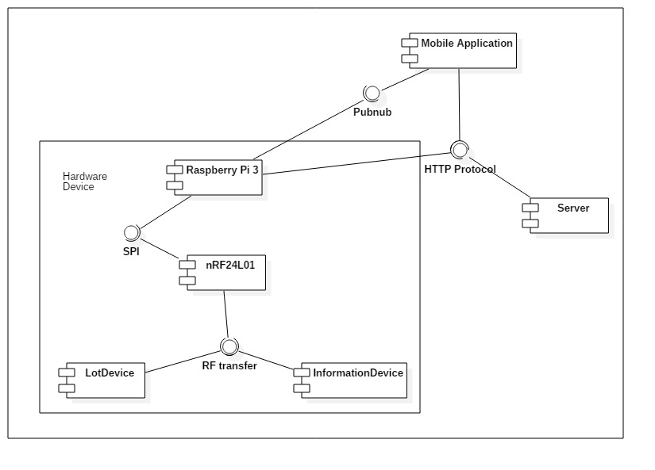
How the system works

Slide 24
Web Server

Slide 25
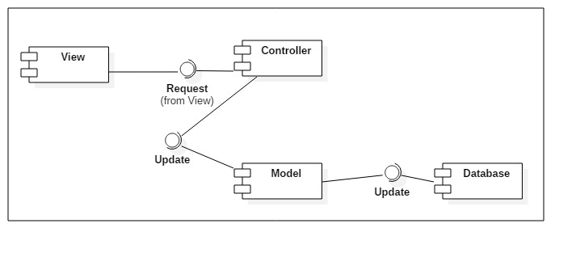
Web Server

Slide 26


Web Service
Database
Web server

Slide 27
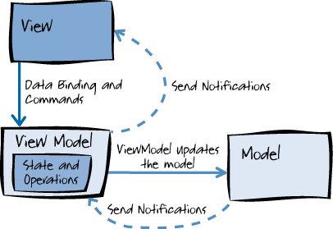
Web Service

Slide 28
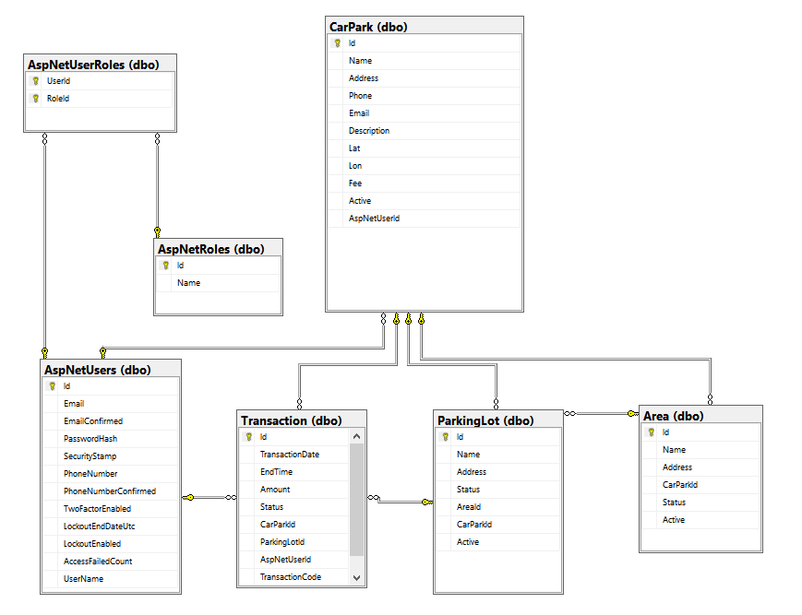
Web Service

Slide 29
Hardware

Slide 30
Hardware

Slide 31
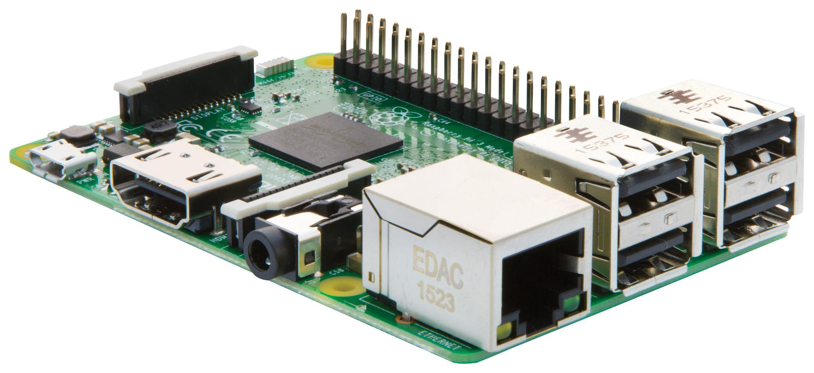
Hardware
Raspberry Pi 3

Slide 32
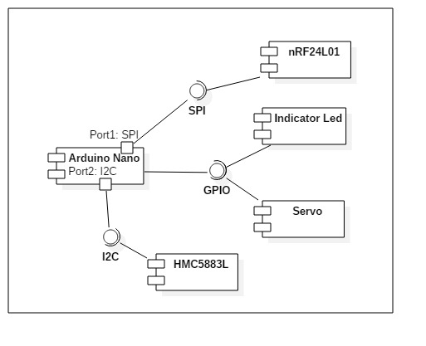
Hardware
Lot Node

Slide 33
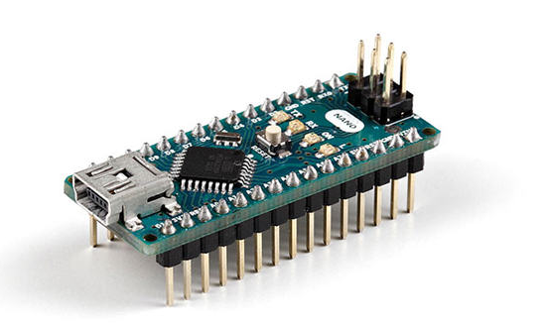
Hardware
Lot Node
Arduino Nano

Slide 34
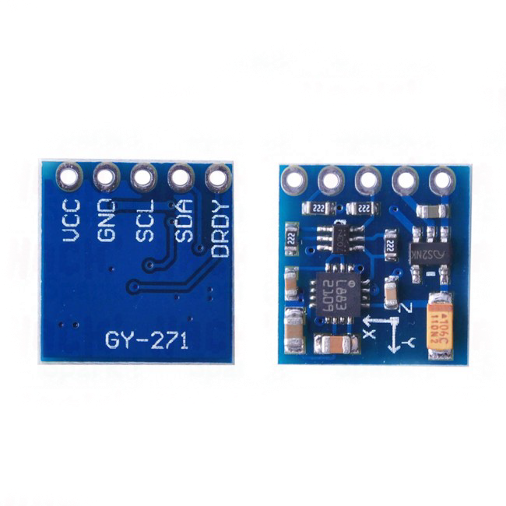
Hardware
Lot Node
Arduino Nano
Arduino Nano
HMC5883L
HMC5883L

Slide 35
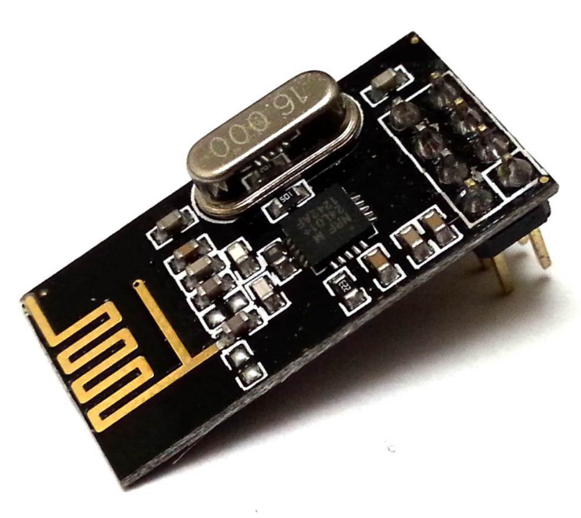
Hardware
Lot Node
Arduino Nano
HMC5883L
nRF24L01+

Slide 36
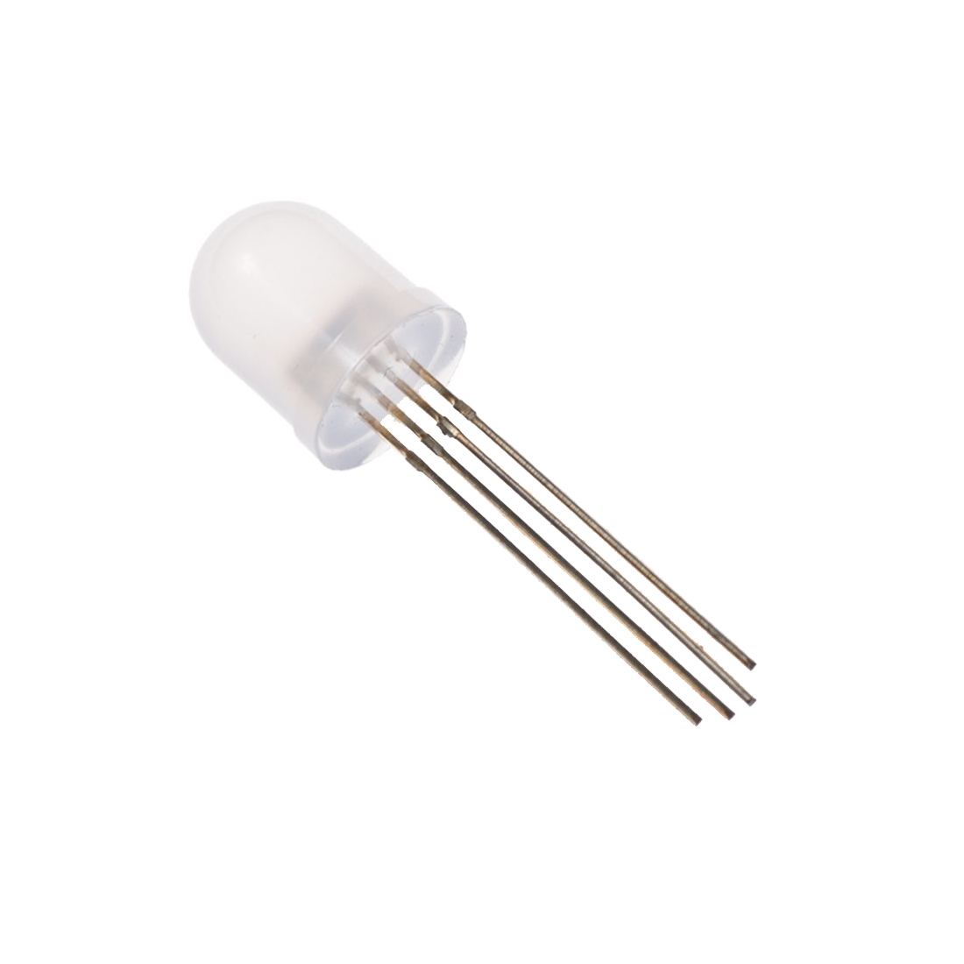
Hardware
Lot Node
Arduino Nano
HMC5883L
nRF24L01+
Led RGB

Slide 37
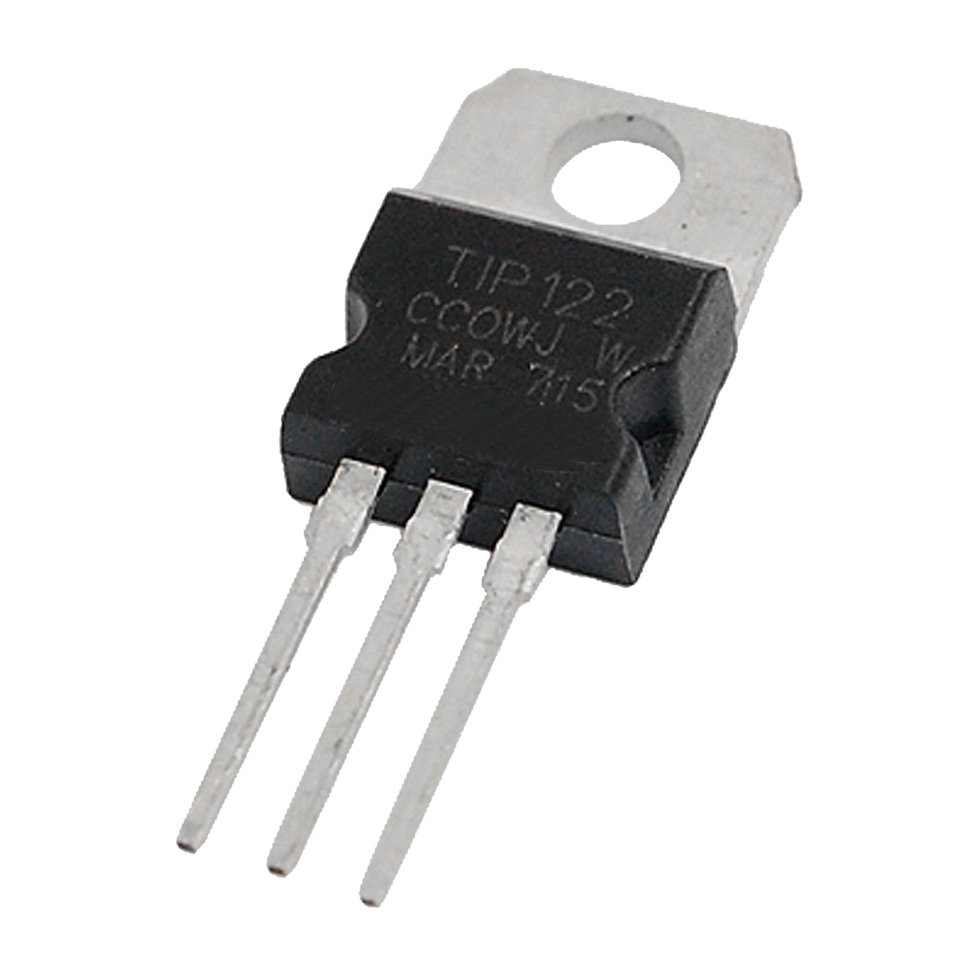
Hardware
Lot Node
Arduino Nano
HMC5883L
nRF24L01+
Led RGB
TIP122

Slide 38
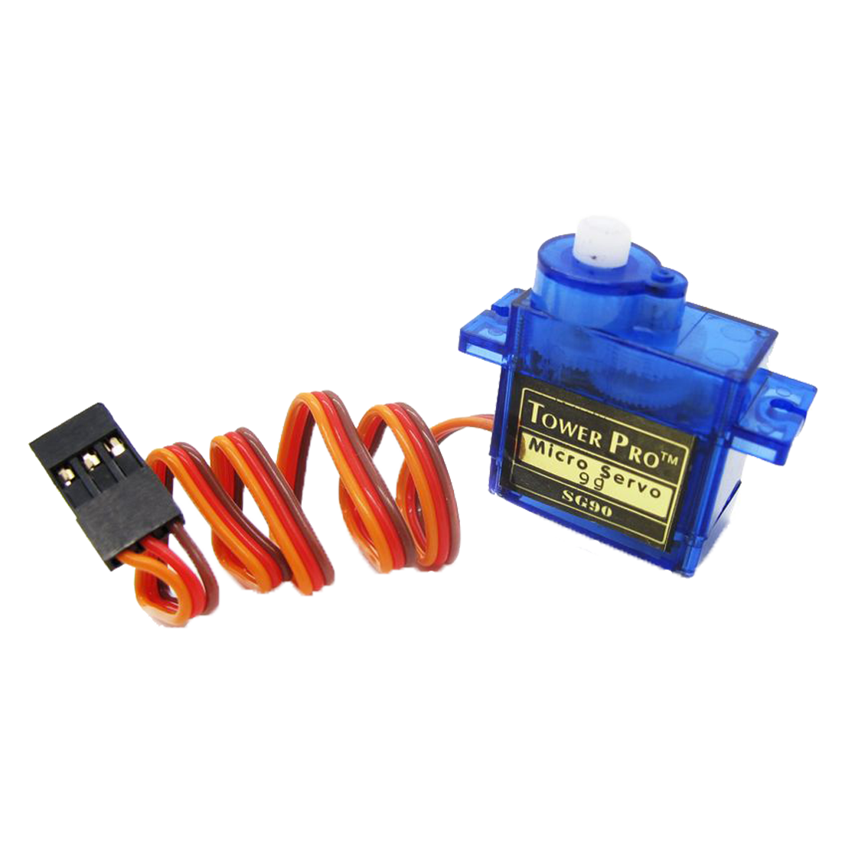
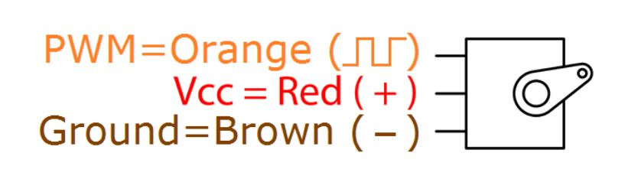
Hardware
Lot Node
Arduino Nano
HMC5883L
nRF24L01+
Led RGB
Servo Motor

Slide 39
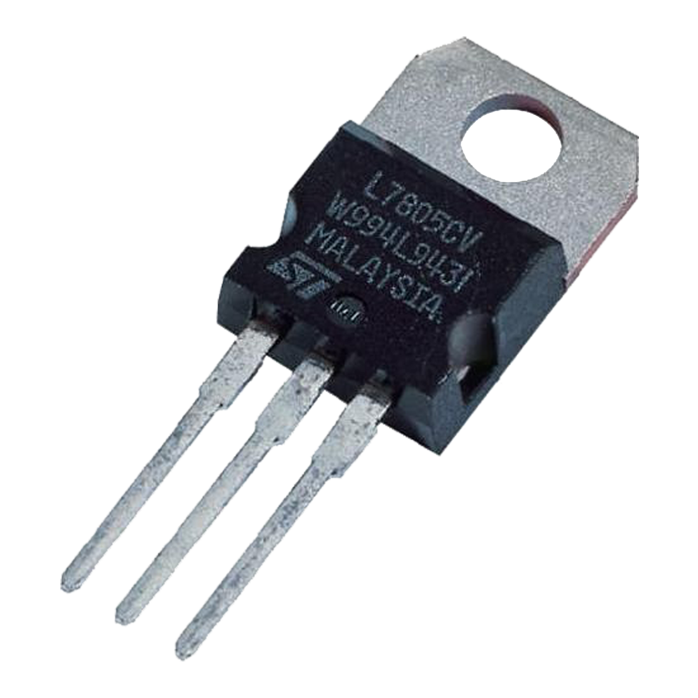
Hardware
Lot Node
Arduino Nano
HMC5883L
nRF24L01+
Led RGB
Servo Motor
LM7805

Slide 40
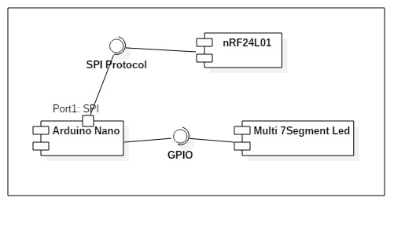
Hardware
Sign Node

Slide 41
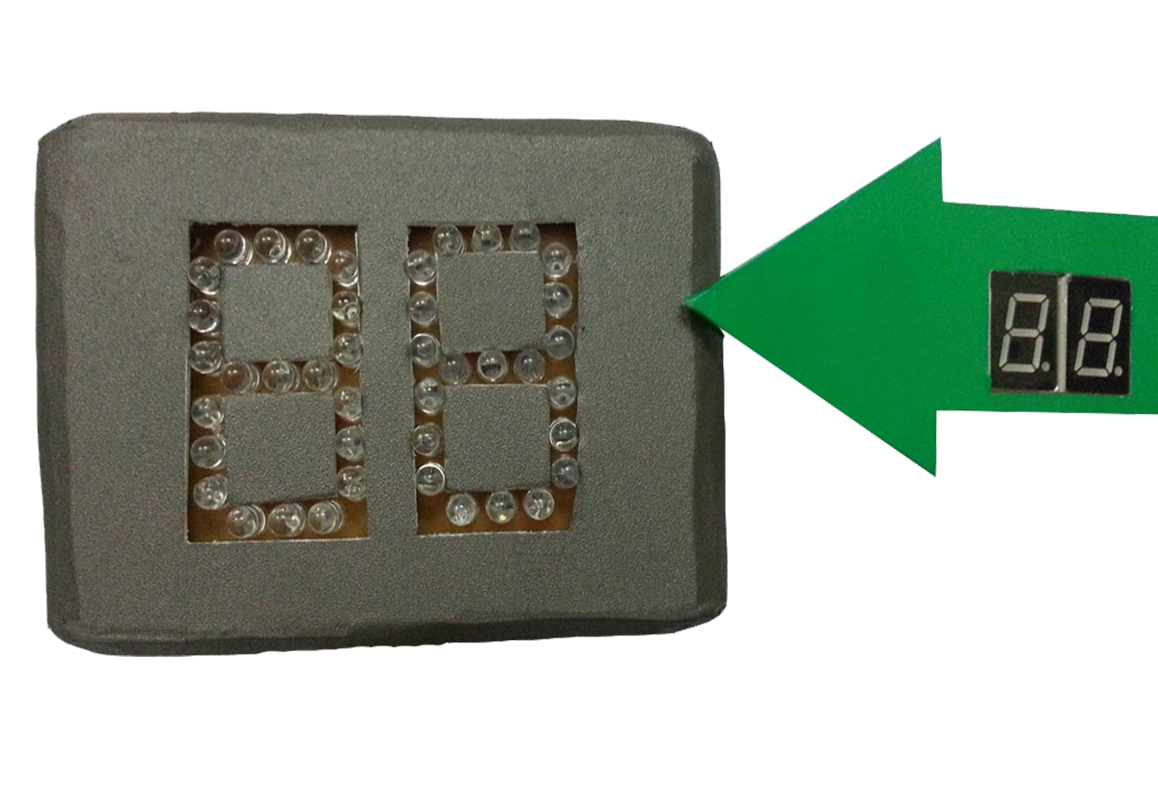
Hardware
Sign Node
Arduino Nano
nRF24L01+
7-segment LED

Slide 42
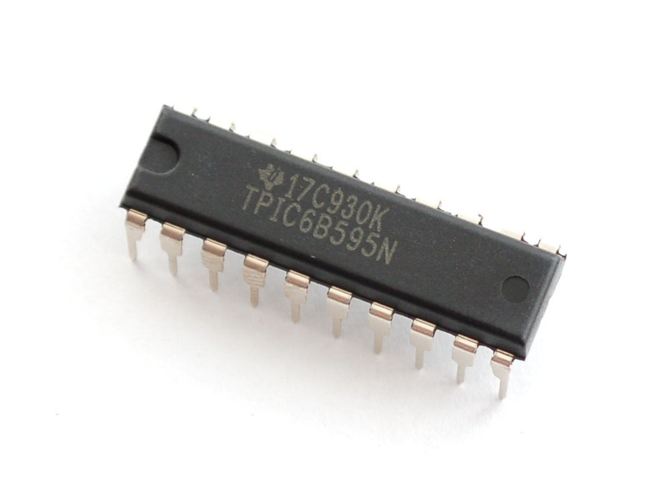
Hardware
Sign Node
Arduino Nano
nRF24L01+
7-segment LED
TPIC6B595N

